Slide 1
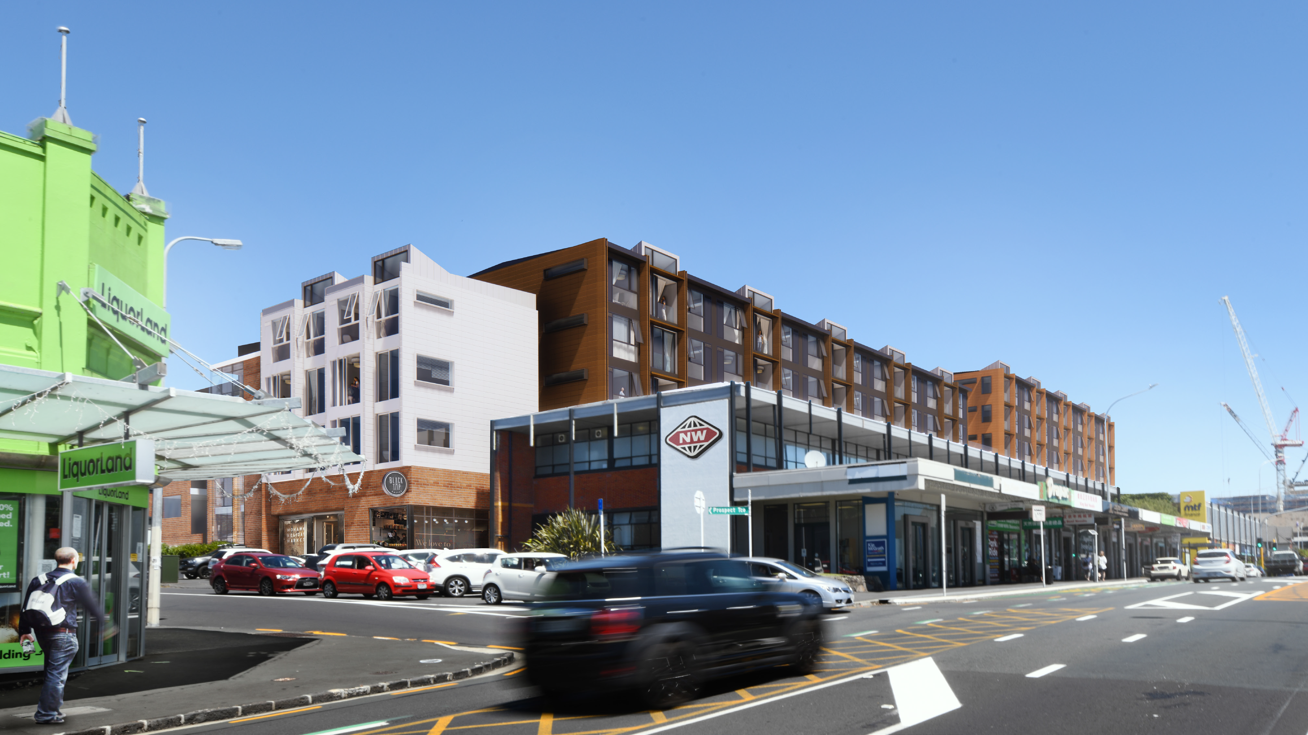
Community Consultation Evening
18 May 2021

Slide 2
Important guiding principles of Mixed-use developments
A strong focus to be placed on alternative modes of travel, other than private vehicles
Importance of public transport, walking, cycling and personal safety
Design of the development has sought to separate out pedestrian and vehicle access by placing the vehicle access on the side roads and placing a strong focus on pedestrian activity in the vicinity of the pedestrian signals on the Dominion Road frontage
Notes:
We are here this evening to speak about the key findings of the integrated transport assessment and ask any questions that you might have about the findings.​
​
We would first like to introduce the principals for the broader Auckland and Transport planning perspective ​
​
The Unitary plan seeks to facilitate transport choices, recognise different trip characteristics and enable accessibility and mobility for all sectors of the community​
​
The Development proposal provides a specific opportunity for mixed-use – retail, commercial and residential activity - to intensify in a form that exemplifies the promotion of a well-functioning urban environment that will promote the use of alternative modes and reduce car travel.​
The plan considers the increase in alternative modes of travel including active and public transport, noting that Auckland council are focussed on reducing the reliance on private vehicles in order to decongest the city through investment in a network that supports and promotes public and active modes of transport. ​
The design of the development has sought to separate pedestrian and vehicle access by placing the vehicle access on the side roads and placing a strong focus on pedestrian activity in the vicinity of the pedestrian signals on the Dominion Road frontage encouraging a safe and accessible environment for pedestrians. ​

Slide 3
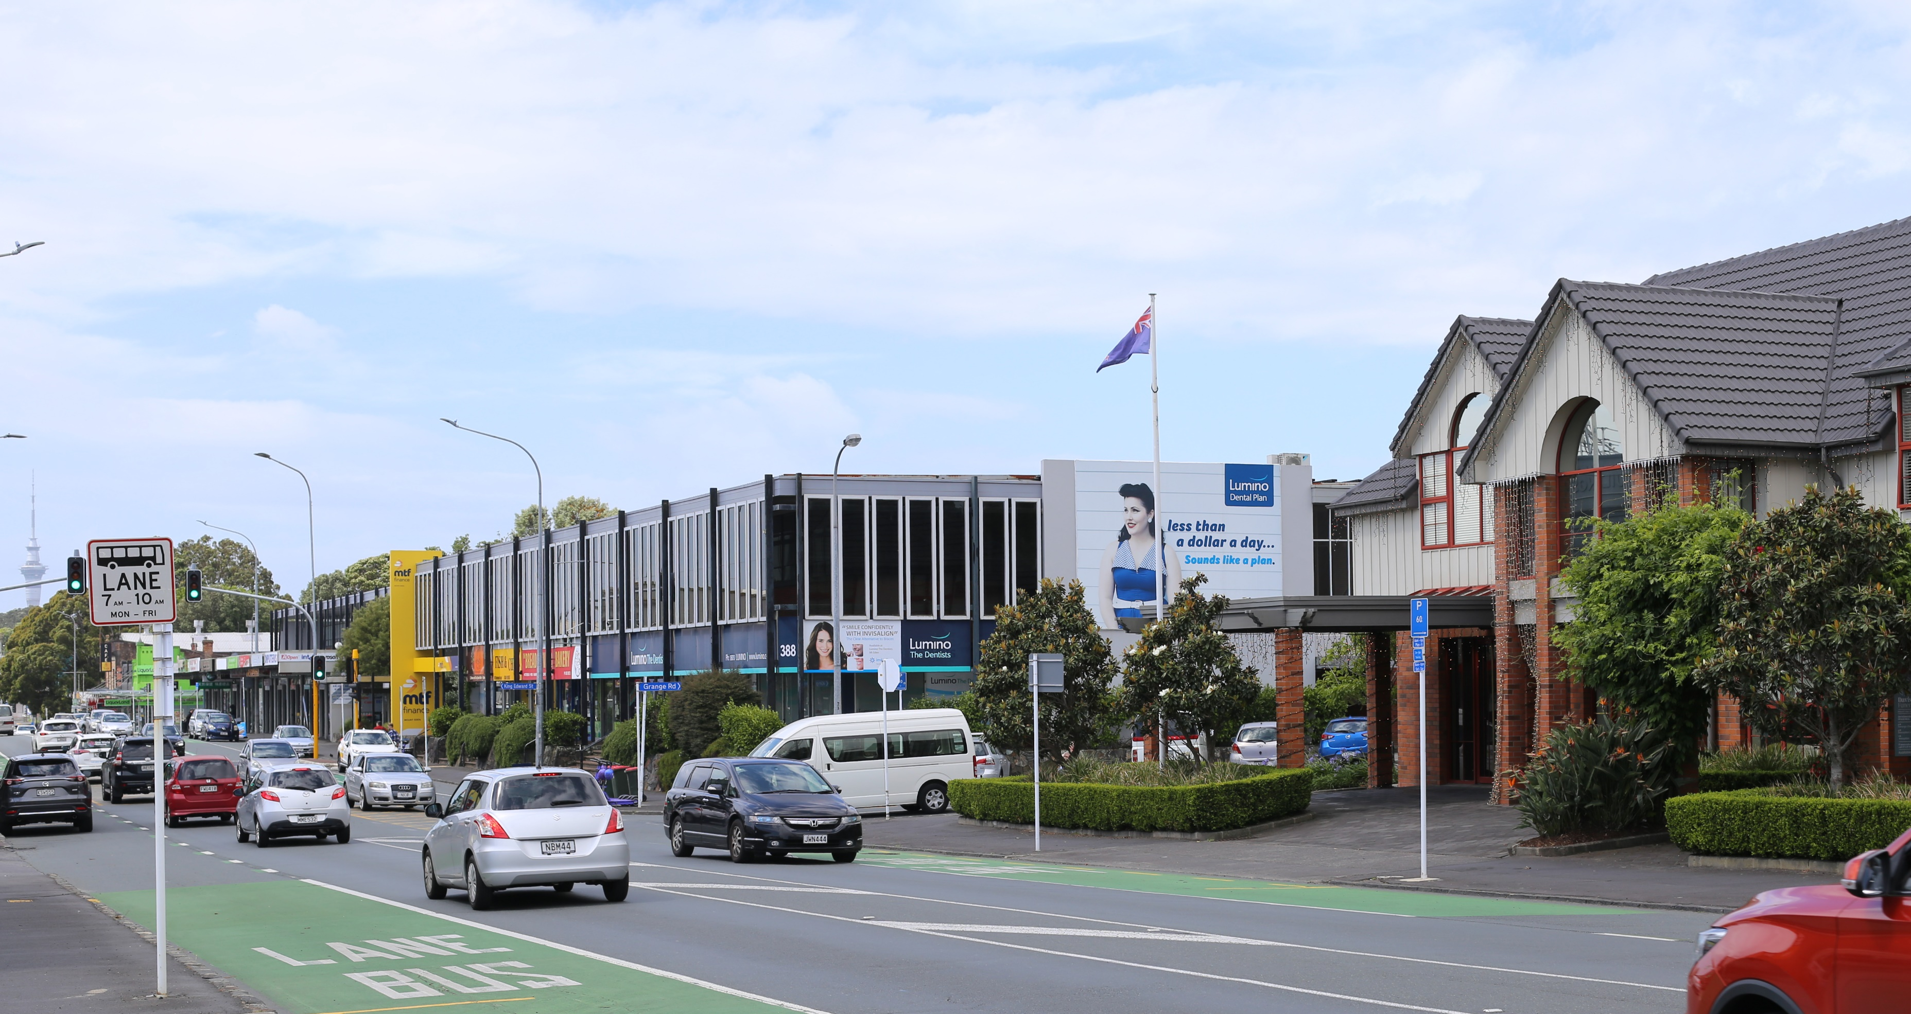
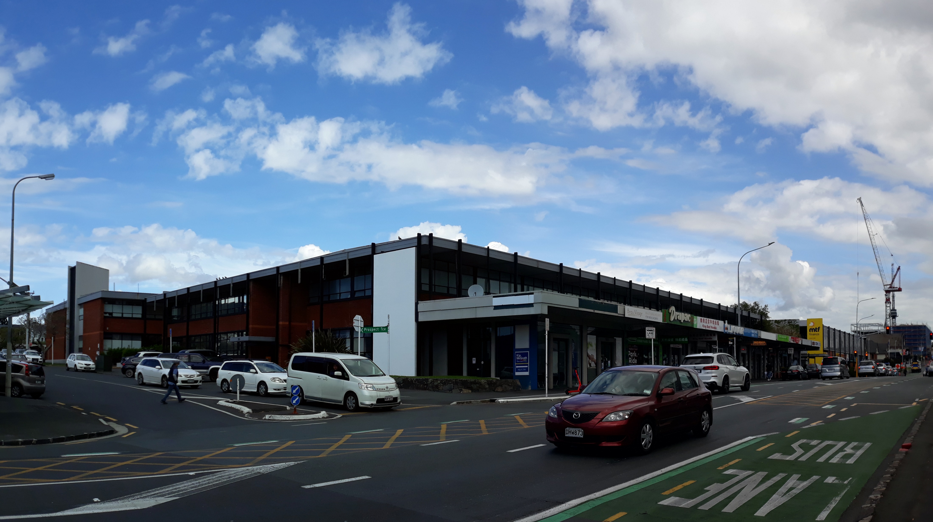
Overview of transport assessment
Methodology has been agreed and scrutinised by Auckland Transport
The proposed flows not considered to be excessive and will not affect the general operation and safety of the side roads
With the proposed mitigations immediately adjacent to the site, the safety and amenity of pedestrians and cyclists will be enhanced.
Road network can accommodate the type of comprehensive mixed-use development that is proposed
Public transport efficiently will continue to operate close to current levels
Notes:
During early discussions with Auckland Transport, it was agreed that the priorities for assessment of effects would be……public transport efficiency, road safety, accessibility of alternative modes and private vehicle traffic flow. The methodology of the transport assessment therefore focused on this order of priority.
The traffic modelling methodology undertaken was also agreed and scrutinised by Auckland Transport.
One of the inevitable outcomes of development will be the need to accept additional traffic on the road network. However, the overall conclusion is that, in the context of the already very busy transport environment in this part of Auckland, the road network can accommodate the proposed mixed-use development.
The key points to note are that:
public transport can continue operate close to its current levels.
The road network can accommodate the additional flow and are not considered excessive.
The proposed mitigations near the site will enhance the safety and amenity for pedestrians and cyclists.
I will talk a little more about those mitigations latter.

Slide 4
A little more discussion on modelling results
The predicted changes in journey times for general traffic during peak periods along this section of Dominion Road during peak periods are acceptable. The baseline and development traffic models indicate a level of congestion during peak times that will contribute to influencing
travel choices during those peak times.
During most other periods of the day, the increases in queuing and delay will be much lower and Dominion Road will continue to operate efficiently for all road users.
Traffic flows on side roads are considered to remain within acceptable levels and together with the proposed mitigations there is no material increases in queues and delays approaching Dominion Road.
The modelling results indicate that bus travel times along Dominion Road during the critical weekday PM peak will remain neutral for southbound buses and increase by about 15% for northbound vehicles.
Notes:
The key results from the traffic modelling were as follows:​
The proposed development will generate additional traffic on the road network, both along the arterial route of Dominion Road and, to a lesser extent, on the residential roads surrounding the site.​
My assessment indicates that congestion and queuing on Dominion Road does occur at present during peak periods (particularly in the southbound direction) and as expected, this congestion will increase as a result of the proposed development. ​
The traffic modelling analysis undertaken as part of this assessment indicates that public transport efficiency will remain fairly neutral, during the evening PM peak period when demand for its use is at it highest​.
There are increases in journey times for general traffic along the section of Dominion Road we modelled, but I consider these to be acceptable in the context of a very busy transport environment.
The congestion that does occur on Dominion Road, including extensive queuing in the southbound direction during the weekday PM peak and the northbound direction during the Saturday peak is primarily caused by congestion back from the existing signals to the south and north of the site, respectively. ​
In terms of intersection performance for each of the nearby side roads, there is no material increases in queues and delays on the side roads.

Slide 5
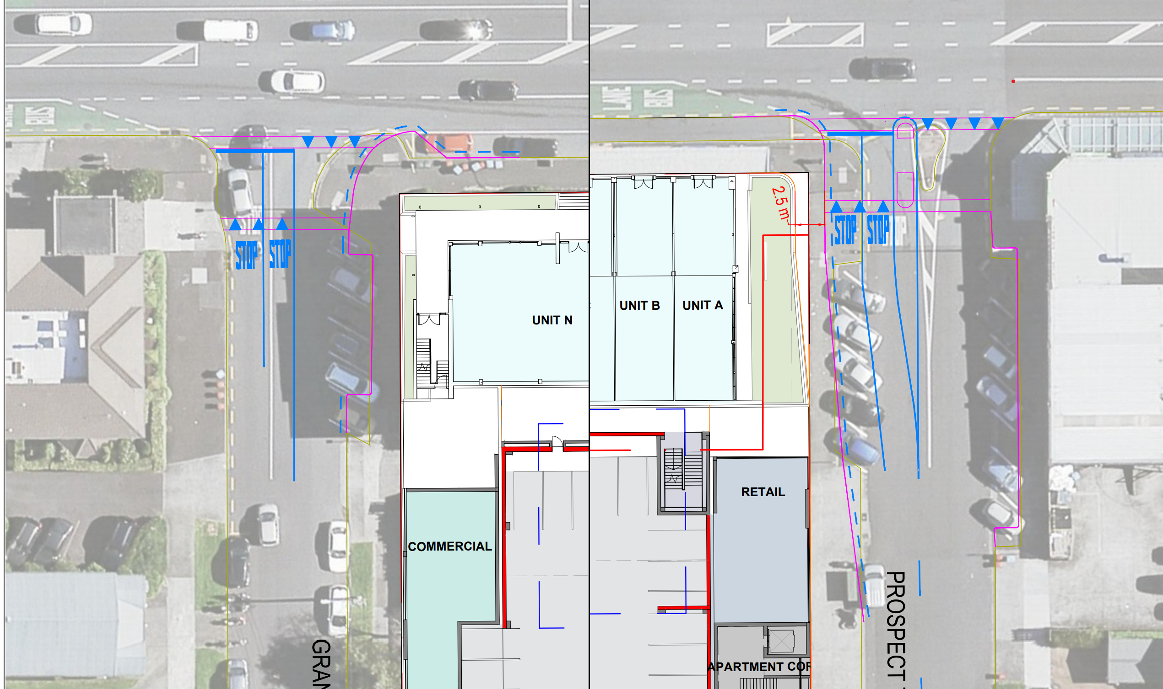
Proposed Mitigations – Prospect Terrace and Grange Road
Notes:
The key changes in around the site include various measures to both enhance pedestrian amenity and safety as well as minimising any effects on Prospect Terrace and Grange Road.
For Prospect Terrace these include:
Removal of the angled parking on the north and south side to increase footpath widths and improve sight lines when crossing the road
Upgrade of the central island at the intersection to assist with crossing the road
Adding a raised table to manage approach speeds assist pedestrians crossing
Adding an additional approach lane to minimise delays at the intersection and promote Dominion Road and the primary road to access the site
For Grange Road these include:
Removal of the angled parking on the north side to increase footpath widths and improve sight lines when crossing the road
Adding a raised table to manage approach speeds assist pedestrians crossing
Adding an additional approach lane to minimise delays at the intersection and promote Dominion Road and the primary road to access the site

Slide 6
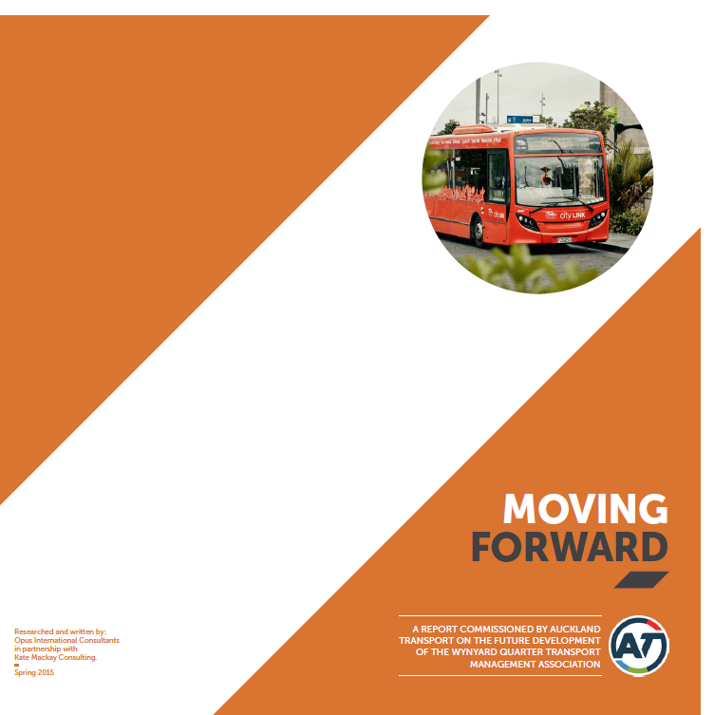
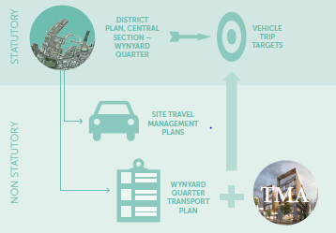
What else can be done?
Establishment of a Travel Demand Management Plan
- A good example are initiatives underway at Wynyard Quarter
Various options have been tested to determine the appropriate mitigation measures to address the effects of the proposed development. All have varying levels of effects across different modes.
Any changes to the network requires Auckland Transport input. They continue to monitor and investigate methods to increase the accessibility of public transport and alternative modes and minimise congestion.
Notes:
Our assessment considered other opportunities to manage effects including:
Signalising the Prospect Terrace intersection with Dominion Road
Adding bus priority measures northbound on Dominion Road during the PM peak
Improvements to the operation of intersections along Dominion Road may also be possible through the better coordination and optimisation of their signal operation
Each of these measures and in fact any changes to the network require Auckland Transport support. They are continuing to monitor and investigate to improve travel across all modes.
In terms of the development, the transport assessment also identified the need for a Travel Demand Management Plan. These set targets and action plans focused on promoting alternative modes and reducing single trip car travel. The ongoing implementation of these plans can also have a significant impact on mitigating effects.

Slide 7
Question time

